Slide 1
Function And Functional Programming In Python

Slide 2
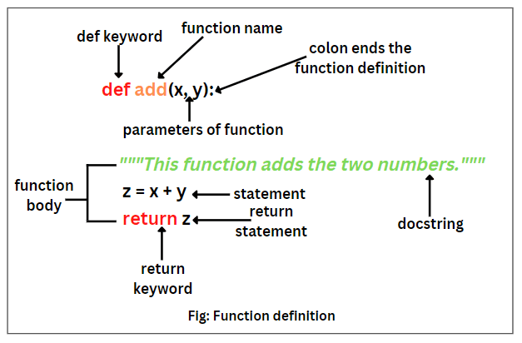
Introduction to Functions in Python
Functions are reusable blocks of code that perform a specific task.
They help improve code organization and readability by encapsulating logic.
Python provides built-in functions as well as the ability to define custom functions using the `def` keyword.
Notes:
Image source: https://pynative.com

Slide 3
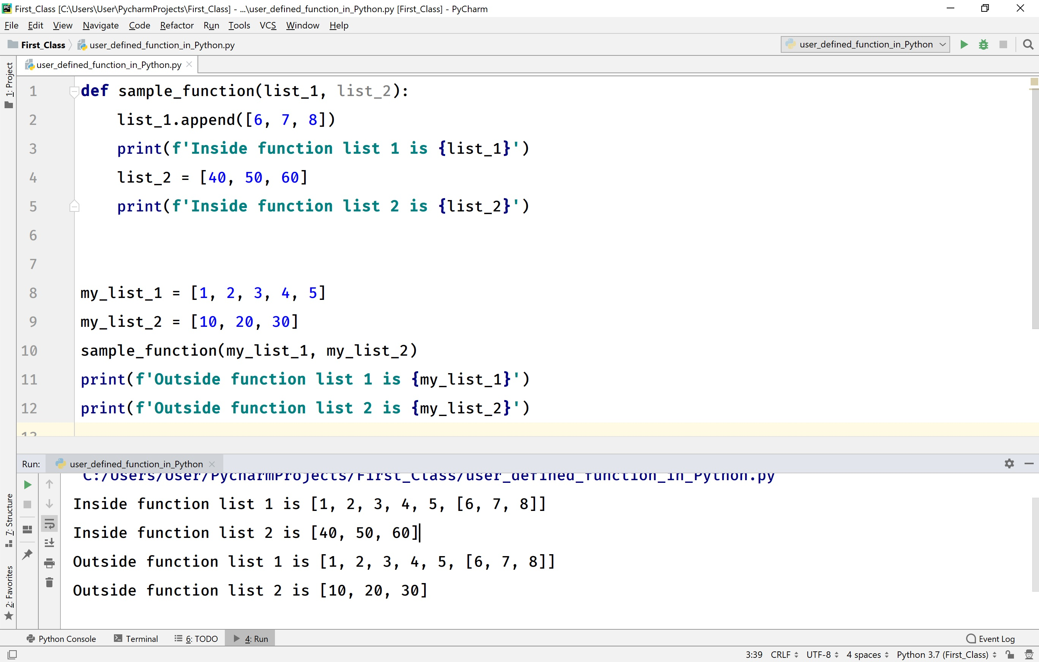
Basic Function Concepts
A function in Python is defined using the `def` statement followed by the function name and parentheses.
Functions can accept parameters to make them more flexible and versatile.
They can also return values using the `return` statement, enabling the transfer of results to the caller.
Notes:
Image source: https://www.btechsmartclass.com

Slide 4

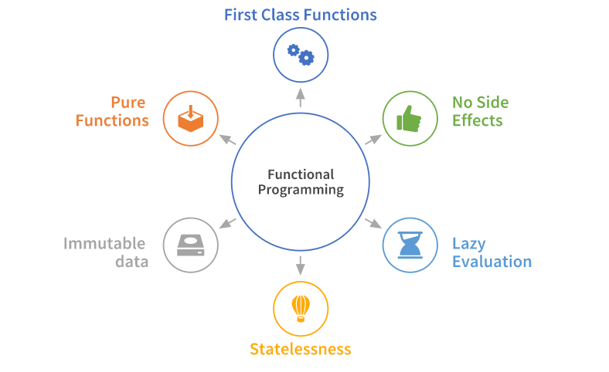
Introduction to Functional Programming
Functional programming emphasizes the use of pure functions, which have no side effects and return consistent outputs for the same inputs.
It encourages the use of immutable data and avoids changing state or mutable data.
Python supports functional programming principles through features like higher-order functions and lambda expressions.
Notes:
Image source: https://www.slidemake.com

Slide 5
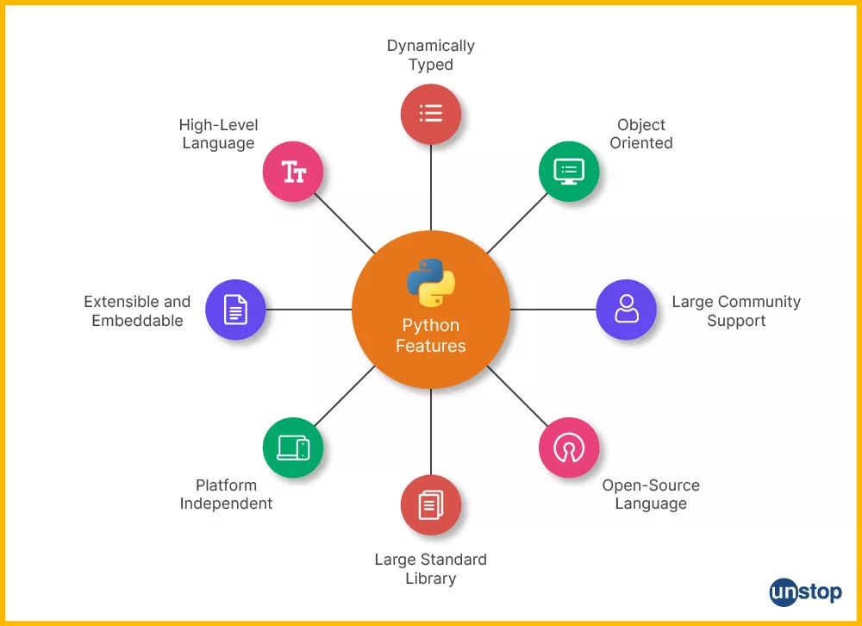
Key Functional Programming Tools in Python
`map()`, `filter()`, and `reduce()` are essential functions for processing collections in a functional style.
Lambda functions allow for creating anonymous, inline functions to simplify code.
List comprehensions and generator expressions provide concise ways to generate and manipulate sequences.
Notes:
Image source: https://files.realpython.com

